Slide 1
Pandas
Dr. Noman Islam

Slide 2
Introduction
It contains data structures and data manipulation tools designed to make data cleaning and analysis fast and easy in Python.
Pandas is designed for working with tabular or heterogeneous data.
NumPy, by contrast, is best suited for working with homogeneous numerical array data.

Slide 3

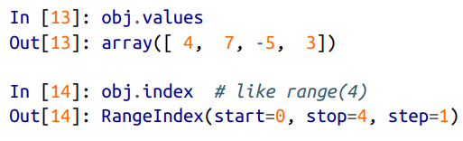
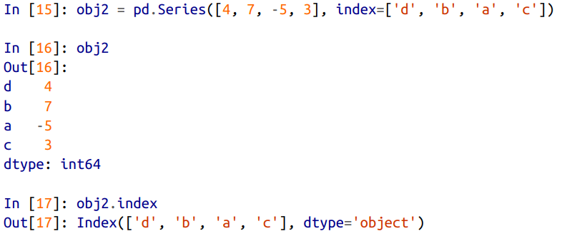
Series

Slide 4
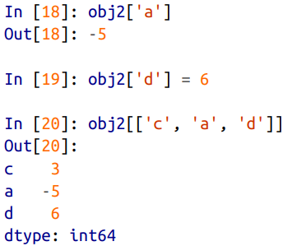
Using indexes to access data

Slide 5
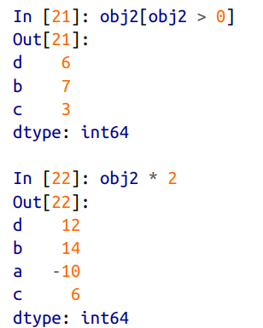

Filtering

Slide 6
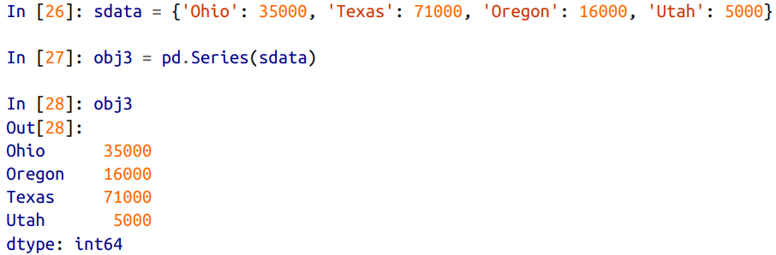
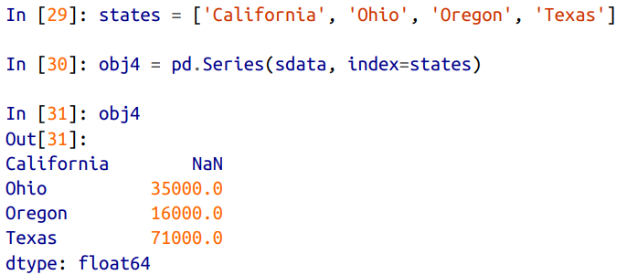
Creating series from dictionary

Slide 7
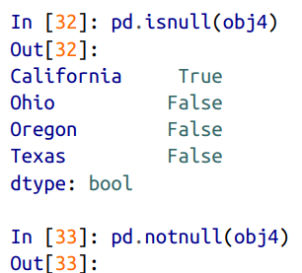
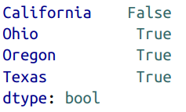
Checking for null values

Slide 8
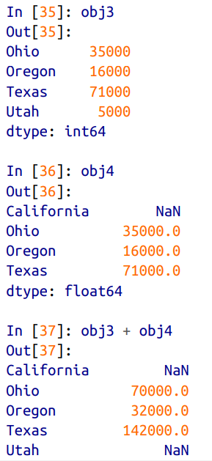
Adding two series

Slide 9
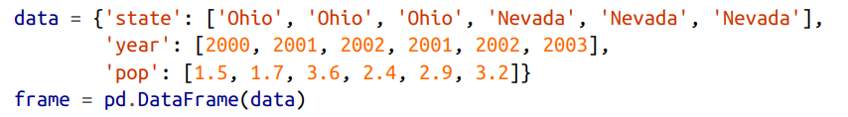
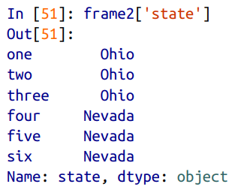
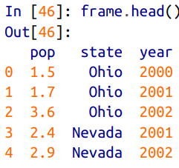
Dataframe

Slide 10
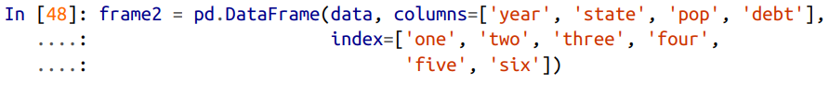
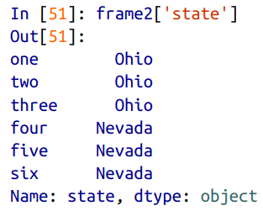
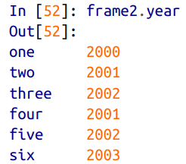
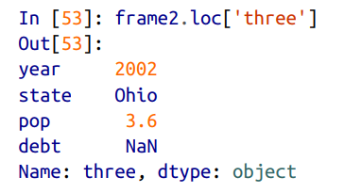

Slide 11
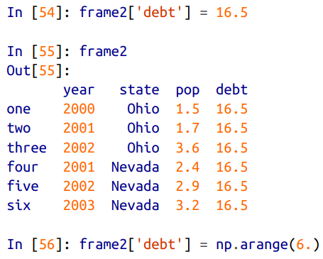
Modifying column values

Slide 12
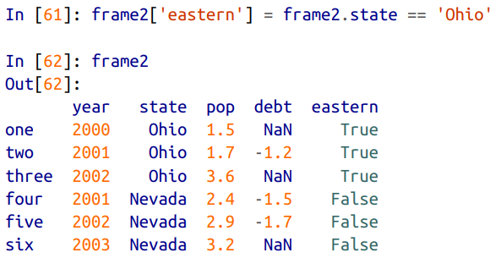
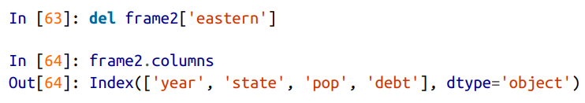
Adding / deleting a new column

Slide 13
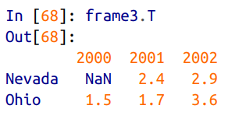
Transpose a dataframe

Slide 14
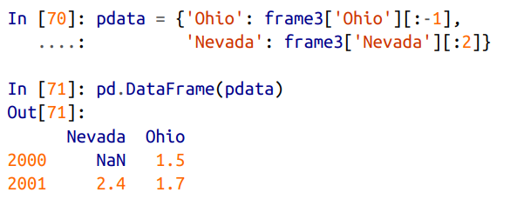
Slicing in dataframe

Slide 15
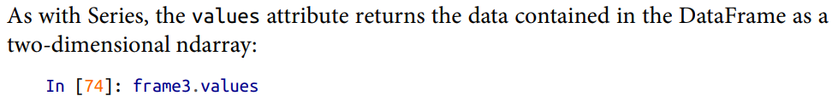
Values attribute

Slide 16
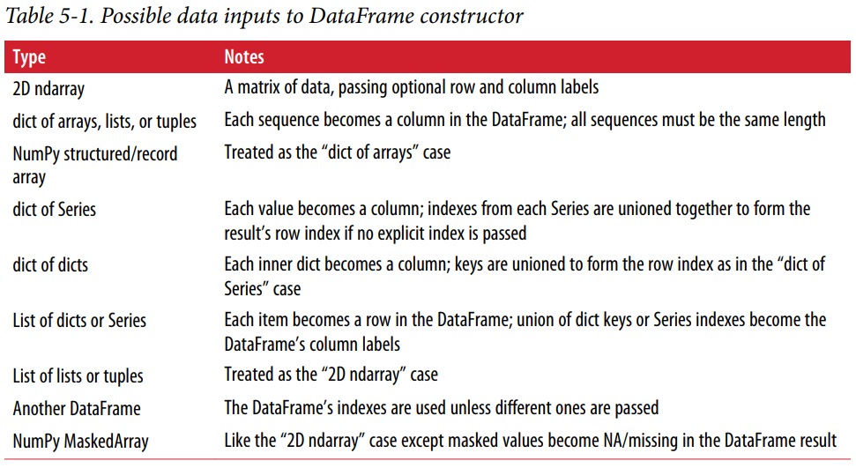

Slide 17
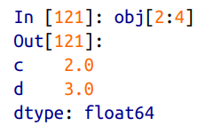
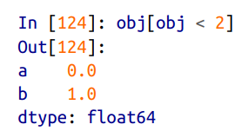
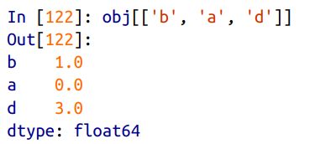
Indexing, selection and filtering

Slide 18
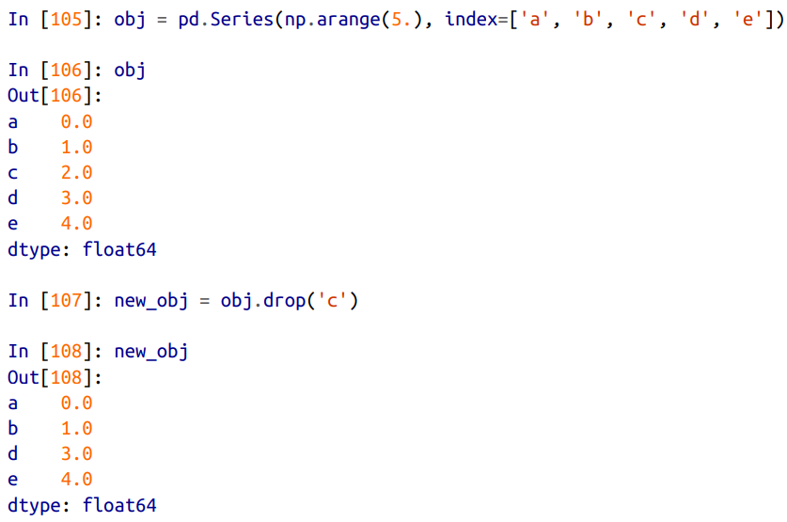
Dropping entries from axis

Slide 19
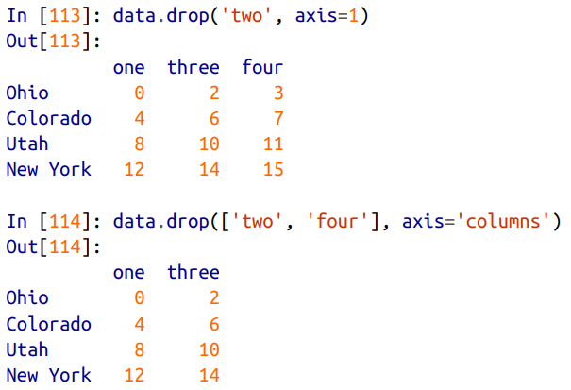
Axis parameter

Slide 20

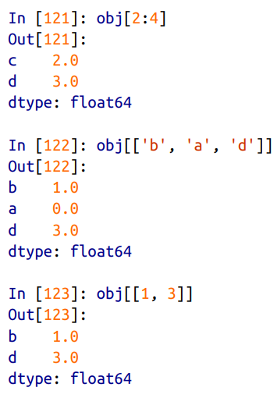

Indexing and slicing

Slide 21
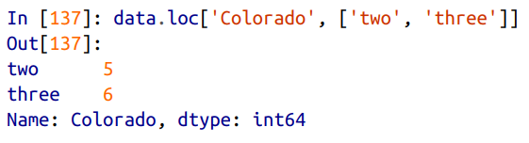
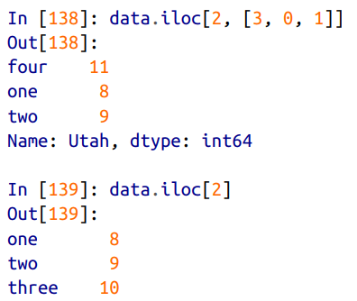
Selection with loc and iloc

Slide 22
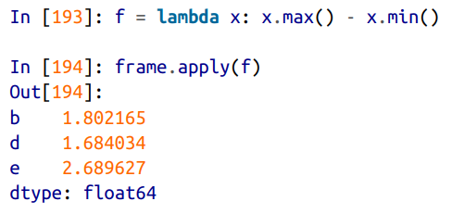
Apply function

Slide 23
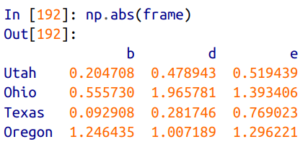
Function application and mapping

Slide 24
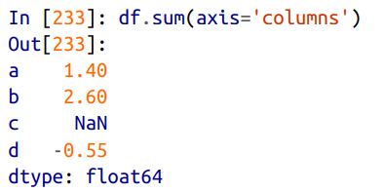
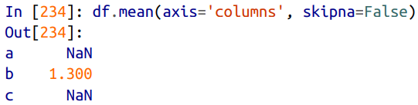
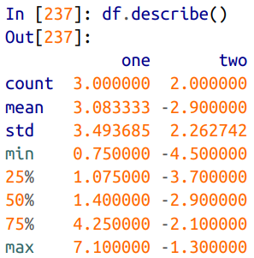
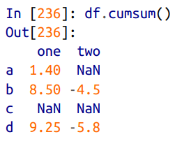
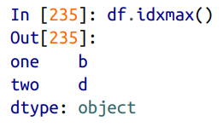
Descriptive statistics

Slide 25
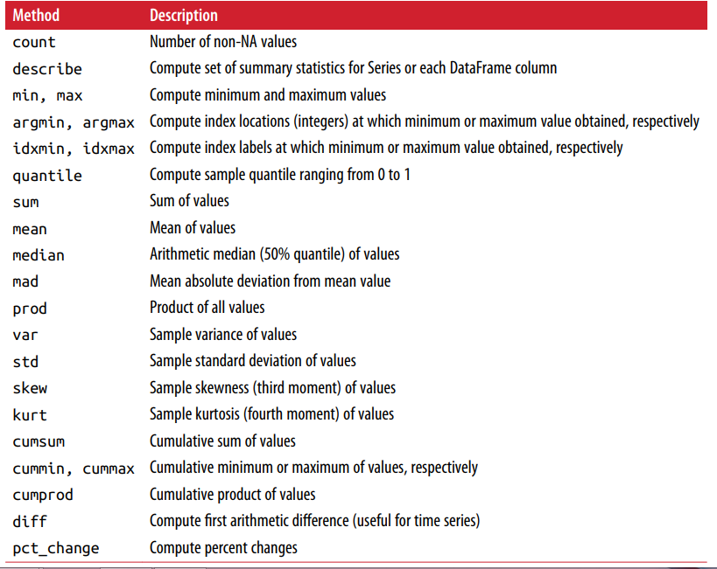

Slide 26
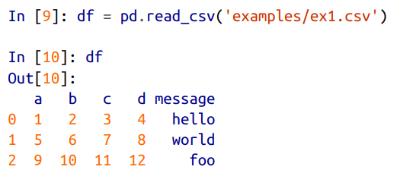
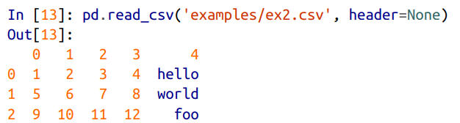
Reading and writing data

Slide 27
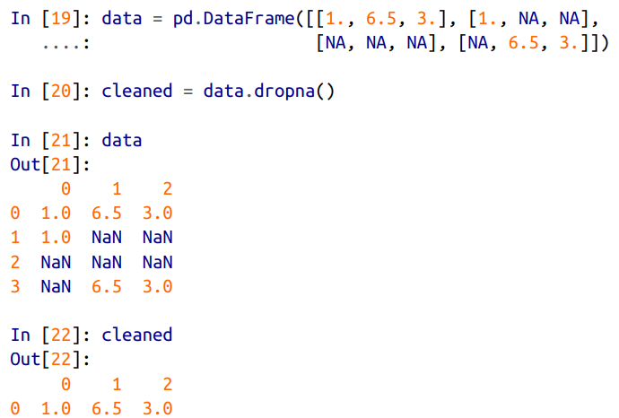
Filtering out missing values

Slide 28
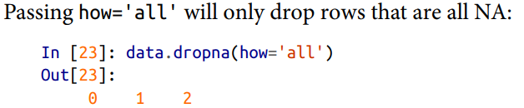

Slide 29

Filling missing data

Slide 30
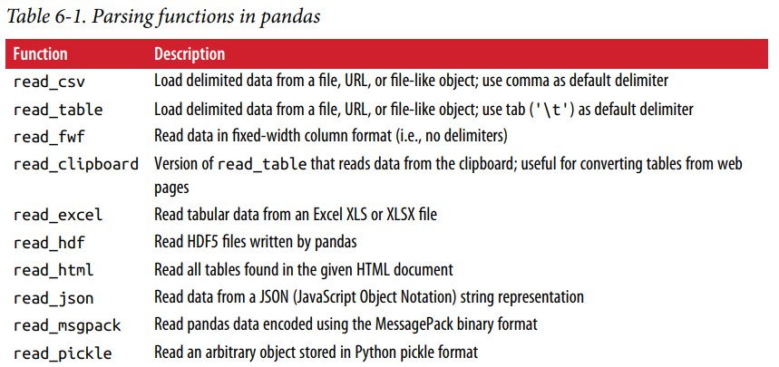
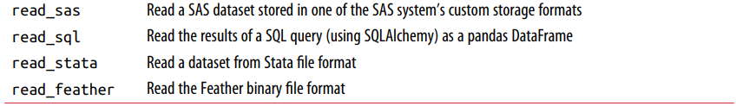
Reading data in pandas

Slide 31
Optional arguments
Indexing Can treat one or more columns as the returned DataFrame, and whether to get column names from the file, the user, or not at all. Type inference and data conversion This includes the user-defined value conversions and custom list of missing value markers.
Datetime parsing Includes combining capability, including combining date and time information spread over multiple columns into a single column in the result.
Iterating Support for iterating over chunks of very large files.
Unclean data issues Skipping rows or a footer, comments, or other minor things like numeric data with thousands separated by commas.

Slide 32
Examples
df = pd.read_csv('examples/ex1.csv')
pd.read_table('examples/ex1.csv', sep=',')
pd.read_csv('examples/ex2.csv', header=None)
pd.read_csv('examples/ex2.csv', names=['a', 'b', 'c', 'd', 'message'])
names = ['a', 'b', 'c', 'd', 'message']
pd.read_csv('examples/ex2.csv', names=names, index_col='message')

Slide 33
Passing regular expression as separator
result = pd.read_table('examples/ex3.txt', sep='\s+')
Skipping rows
pd.read_csv('examples/ex4.csv', skiprows=[0, 2, 3])

Slide 34

Handling null values

Slide 35
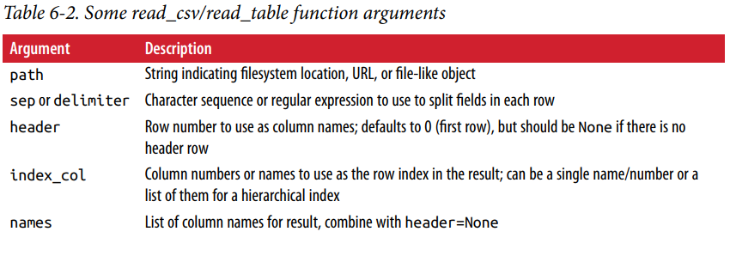

Slide 36
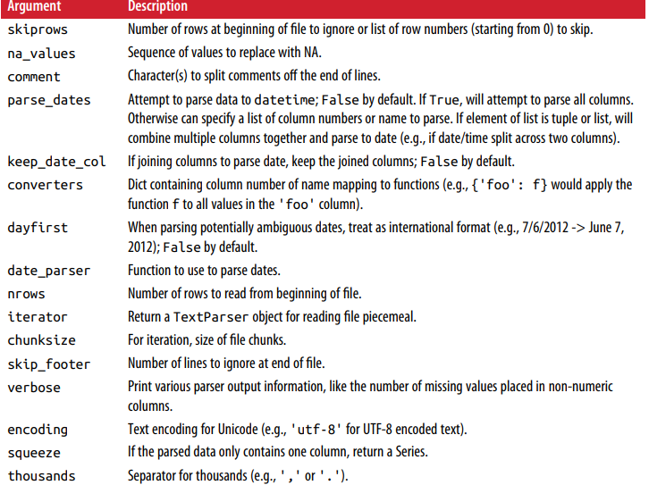

Slide 37
Reading text file in pieces

Slide 38
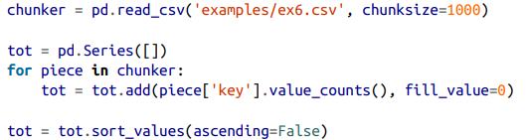
Iterating over chunk

Slide 39

Writing file

Slide 41


Working with delimited format

Slide 42
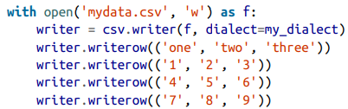
Writing csv data

Slide 43
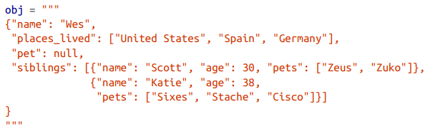
JSON format

Slide 44
The pandas.read_json can automatically convert JSON datasets in specific arrange‐ ments into a Series or DataFrame
The default options for pandas.read_json assume that each object in the JSON array is a row in the table

Slide 45

Web scraping
The pandas.read_html function has a number of options, but by default it searches for and attempts to parse all tabular data contained within tags.

Slide 46


Slide 47
Saving in binary format

Slide 48

HD5 format

Slide 49

Excel format

Slide 50


Interacting with Web API

Slide 51


Slide 52


Interacting with database

Slide 53



Slide 54


Slide 55
Data Cleaning and Preparation

Slide 56

Handling missing data

Slide 57


Slide 58



Slide 59
dropna options
With DataFrame objects, things are a bit more complex. You may want to drop rows or columns that are all NA or only those containing any NAs. dropna by default drops any row containing a missing value
Passing how='all' will only drop rows that are all NA
To drop columns in the same way, pass axis=1
df.dropna(thresh=2)

Slide 60
Filling In Missing Data
Calling fillna with a constant replaces missing values with that value
Calling fillna with a dict, you can use a different fill value for each column
df.fillna({1: 0.5, 2: 0})
fillna returns a new object, but you can modify the existing object in-place:
_ = df.fillna(0, inplace=True)

Slide 61




Slide 62


Slide 63
Removing Duplicates
data.duplicated()
Relatedly, drop_duplicates returns a DataFrame where the duplicated array is False
You can specify any subset of them to detect duplicates
data.drop_duplicates(['k1'])
duplicated and drop_duplicates by default keep the first observed value combina‐ tion. Passing keep='last' will return the last one

Slide 64


Map

Slide 65
Replace
data.replace(-999, np.nan)
data.replace([-999, -1000], np.nan)
data.replace([-999, -1000], [np.nan, 0])
data.replace({-999: np.nan, -1000: 0})

Slide 66


Map with index

Slide 67
Other index methods
data.rename(index=str.title, columns=str.upper)
data.rename(index={'OHIO': 'INDIANA'}, columns={'three': 'peekaboo'})
data.rename(index={'OHIO': 'INDIANA'}, inplace=True)

Slide 68
Discretization and binning
Let’s divide data into bins
ages = [20, 22, 25, 27, 21, 23, 37, 31, 61, 45, 41, 32]
bins = [18, 25, 35, 60, 100]
cats = pd.cut(ages, bins)
Lets see the code for each data and categories:
cats.codes
cats.categories
What are the counts for each category?
pd.value_counts(cats)

Slide 69
Making the left side a close interval
pd.cut(ages, [18, 26, 36, 61, 100], right=False)
Providing your own group names:
group_names = ['Youth', 'YoungAdult', 'MiddleAged', 'Senior']
pd.cut(ages, bins, labels=group_names)

Slide 70
Detecting and filtering outliers
data.describe()
Suppose you wanted to find values in one of the columns exceeding 3 in absolute value:
col = data[2]
col[np.abs(col) > 3]
To select all rows having a value exceeding 3 or –3, you can use the any method on a boolean DataFrame:
data[(np.abs(data) > 3).any(1)]
Here is code to cap values outside the inter‐ val –3 to 3
data[np.abs(data) > 3] = np.sign(data) * 3

Slide 71
Permutation and random sampling
Calling permutation with the length of the axis you want to permute produces an array of integers indicating the new ordering:
df = pd.DataFrame(np.arange(5 * 4).reshape((5, 4))
sampler = np.random.permutation(5)
df.take(sampler)
To select a random subset without replacement, you can use the sample method on Series and DataFrame:
df.sample(n=3)

Slide 72
To generate a sample with replacement (to allow repeat choices), pass replace=True to sample:
choices = pd.Series([5, 7, -1, 6, 4])
draws = choices.sample(n=10, replace=True)

